Slide 1


Predictive analysis Final Project Test_diabetes
Bianca Finol Hernandez –

Slide 2
Objective
The objective of this project is finding factors that could increase the risk of having diabetes

Slide 3
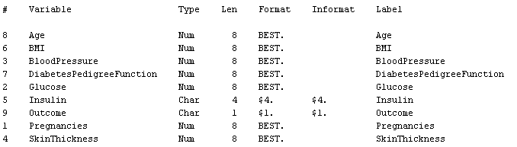
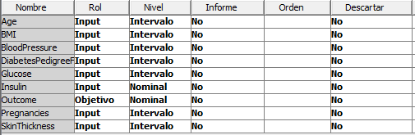
Dataset- 9 variables
Dataset: Test_Diabetes
Target Variable is Outcome
Outcome is a binary variable.
0= no have diabetes
1= have diabetes

Slide 4
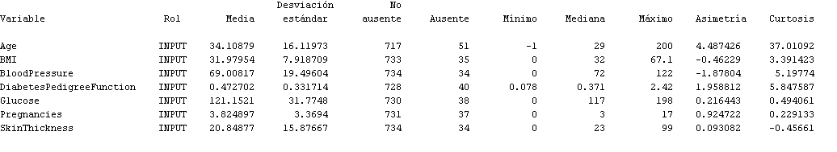
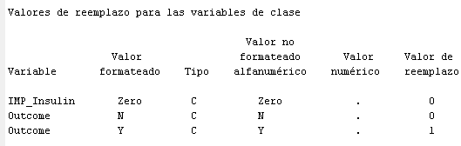
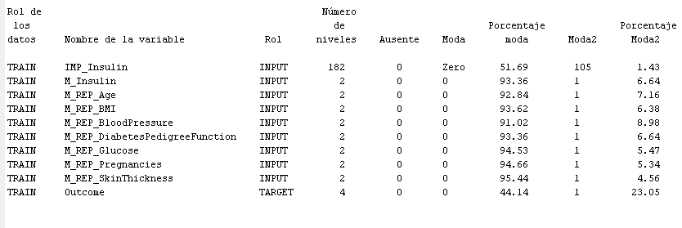
Data preparation – Data cleaning
Missing values
Value of replacement
Zero writing as a character for variable insulin

Slide 5
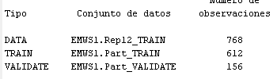
Modelling
Total observations 768
Split the data:
80% for training
20% validation
Training 612
Validation 156
The purpose of split the data are the following:
Prevent overfitting / underfitting
Validate the model with another subset

Slide 6
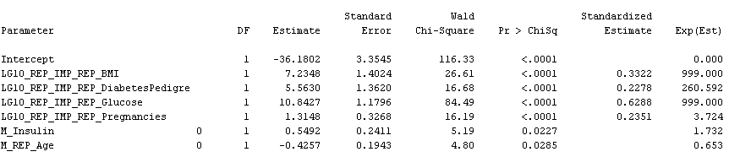
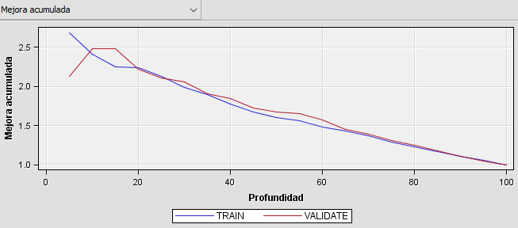
Regression Model - Stepwise
The model end in the 6th step. The variables are the following:
Important variables
BMI
DiabetesPedigree
Glucose
Number of pregnancies
Insulin
Age
Performance of training vs validation data
Variables no consider important for the model
Skin Thickness
Blood pressure

Slide 7
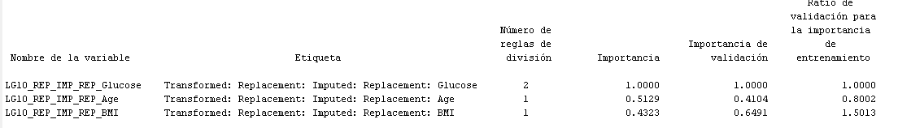
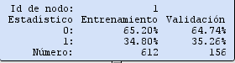
Decision tree
Important variables
Training
Validation
Glucose
BMI
Age

Slide 8
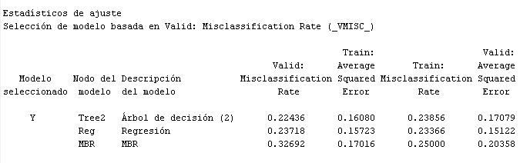
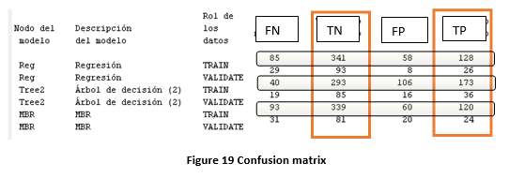
Comparing models
Regression and decision tree show similar values.
KNN was included only in this part as additional models for comparation. But the result for this model are not significantly better
Regression model has more TN for training and validation data.
Decision tree has more TP for training and validation data.
Regarding FN, decision tree shows lower counts FN than regression and KNN.
Confusion Matrix

Slide 9
Conclusion
Regression and decision tree show similar values.
Both models select Glucose, BMI and Age as important variables for determining if a patient has diabetes.
Confusion matrix shows that regression model has more TN, decision tree more TP.

Slide 10
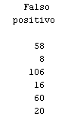
Recommendation
Business should determine if they are agreeing to have False Positive, i.e., if they prefer to have a patient misclassified as diabetic than a patient misclassified as no diabetic.
If they are agreeing to have FP the model recommended is Decision tree.
False
Positive

Slide 11
Thank you

